Slide 1


Forecasting Energy Demand Harnessing Iot Data for Smart Grid Analytics
Data science Project
on
Presented by
Thanushri A
Jeevithaa S

Slide 2
Table of contents
01
02
03
04
05
06
Introduction
Dataset
Data Preprocessing
We will discuss what is energy demand, Smart grids, Challenges and Project Overview
We will describe the dataset we used
Data preparation steps, including cleaning, preprocessing, and feature engineering.
EDA
Forecast Models
Results
The deeper insights from the dataset
Developed Forecast Models for Energy demand using ML
Comparison Of Each model and the best one

Slide 3
01
What is Energy Demand?
Energy demand is the amount of energy that is consumed by a specific system over a given period of time. It's measured in watts (W) for instantaneous power or kilowatt-hours (kWh) for total consumption.

Slide 4
01
What is Smart Grid?
04
A smart grid is a high-tech electricity network that uses sensors and software to deliver power more efficiently. Think of it as a self-adjusting power grid that optimizes electricity flow, reduces waste, and even lets consumers participate in managing usage.

Slide 5
The Challenge of Energy Demand Forecasting
Energy demand fluctuates over time, influenced by various factors. Accurate forecasting is vital for balancing supply and. demand
Inaccurate forecasts can lead to energy shortages or surpluses.
The Rise of Smart Grids
Smart grids integrate digital technologies to optimize energy delivery.
IoT sensors collect real-time data on energy usage and grid conditions.
This data provides valuable insights for forecasting and grid management.
Project Overview: Leveraging IoT Data
This project explores the potential of IoT data for energy demand forecasting.
Data was collected from Kaggle which was created using Iot sensors within a smart grid environment.
The data encompasses factors influencing energy consumption.

Slide 6
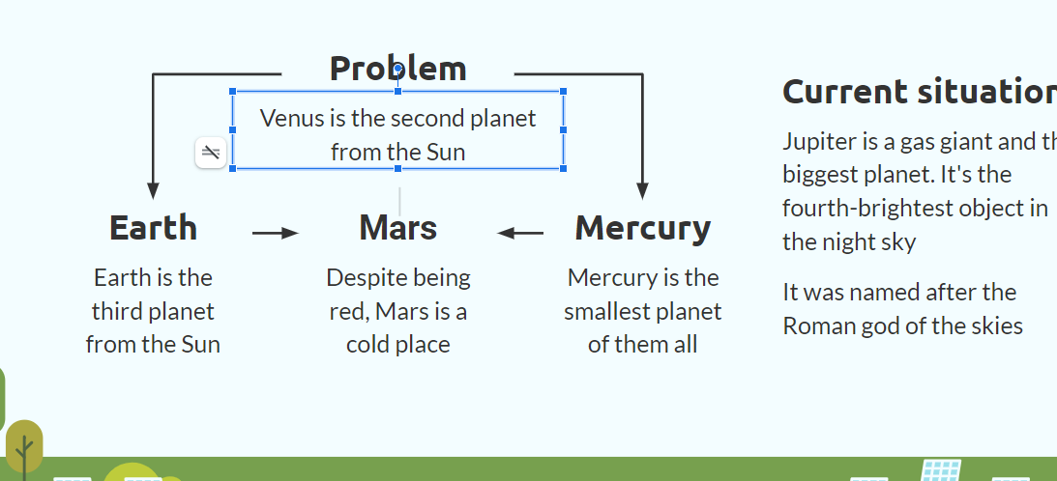
Our Dataset Selection Criteria
02
Dataset
Long-Term Focus
Multivariate Analysis
Captured historical energy demand data to understand trends and patterns over time.
Aimed to capture seasonal variations and long-term changes in consumption habits.
Utilized data from multiple IoT sensors within the smart grid environment.
Included factors influencing energy demand, such as weather data, appliance usage patterns, and industrial activity levels.

Slide 7
Our Dataset
The dataset is titled "Electricity Load - Logistics - IoT" and was obtained from Kaggle: https://www.kaggle.com/datasets/nasirayub2/electricityload-logistics-iot/data.
The dataset spans from January 1, 2015, to January 30, 2024, encompassing a total of 3317 records.
It includes a rich collection of features that capture various aspects of electricity consumption, environmental conditions, and other influencing factors.

Slide 8
Our Dataset Features
Feature | Range | Unit
Timestamp | - | Datetime
Electricity_Load | 500.0 - 999.0 | kW (kilowatts)
Temperature | -10.0 - 34.0 | Celsius (°C)
Humidity | 20.0 - 79.0 | Percentage (%)
Day_of_Week | 0 (Sunday) to 6 (Saturday) | Numerical
Time_of_Day | Morning, Afternoon, Evening, Night | Categorical
Holiday_Indicator | 0 (Not a holiday) or 1 (Holiday) | Numerical
Previous_Load | 500.0 - 999.0 | kW (kilowatts)
Transportation_Data | 10.0 – 49.0 | Numerical
Operational_Metrics | 100.0 – 499.0 | Numerical
IoT_Sensor_Data | 0.0 – 1.0 | Numerical
External_Factors | Regulatory, Economic and other | Categorical
Day_Ahead_Demand | 500.0 - 999.0 | kW (kilowatts)
Real-Time_LMP | 20.0 – 50.0 | $/unit (likely currency)
Regulation_Capacity | 50.0 – 99.0 | kW (kilowatts)
Day_Ahead_LMP | 30.0 – 60.0 | $/unit (likely currency)
Day_Ahead_EC | 5.0 – 20.0 | $/unit (likely currency)
Day_Ahead_CC | 2.0 – 9.99 | $/unit (likely currency)
Day_Ahead_MLC | 1.0 – 5.0 | $/unit (likely currency)
Real-Time_EC | 10.0 – 25.0 | $/unit (likely currency)
Real-Time_CC | 1.0 – 7.99 | $/unit (likely currency)
Real-Time_MLC | 0.5 – 3.0 | $/unit (likely currency)
System_Load | 500.0 - 999.0 | kW (kilowatts)

Slide 9
Data Preprocessing
03
Step 1
Check for missing values in each column and removing them if any
Step 2
The 'Timestamp' column is recognized as an object type, which suggests it is stored as a string. This has been converted to a datetime type for our forecasting model and other necessary columns are extracted and checked we whether it has been updated.
Step 3
Checking for outliers in numerical columns to ensure data quality and we applied Capping outliers; it is a technique used in data analysis to address extreme values that fall outside the typical range of the data. It involves setting thresholds and replacing outlier values with those thresholds.
Step 4
Standardizing categorical data by ensuring consistent casing and removing any leading/trailing spaces and using label encoding and converting them into numerical values for future use.

Slide 10
Exploratory Data Analysis
04

Slide 11
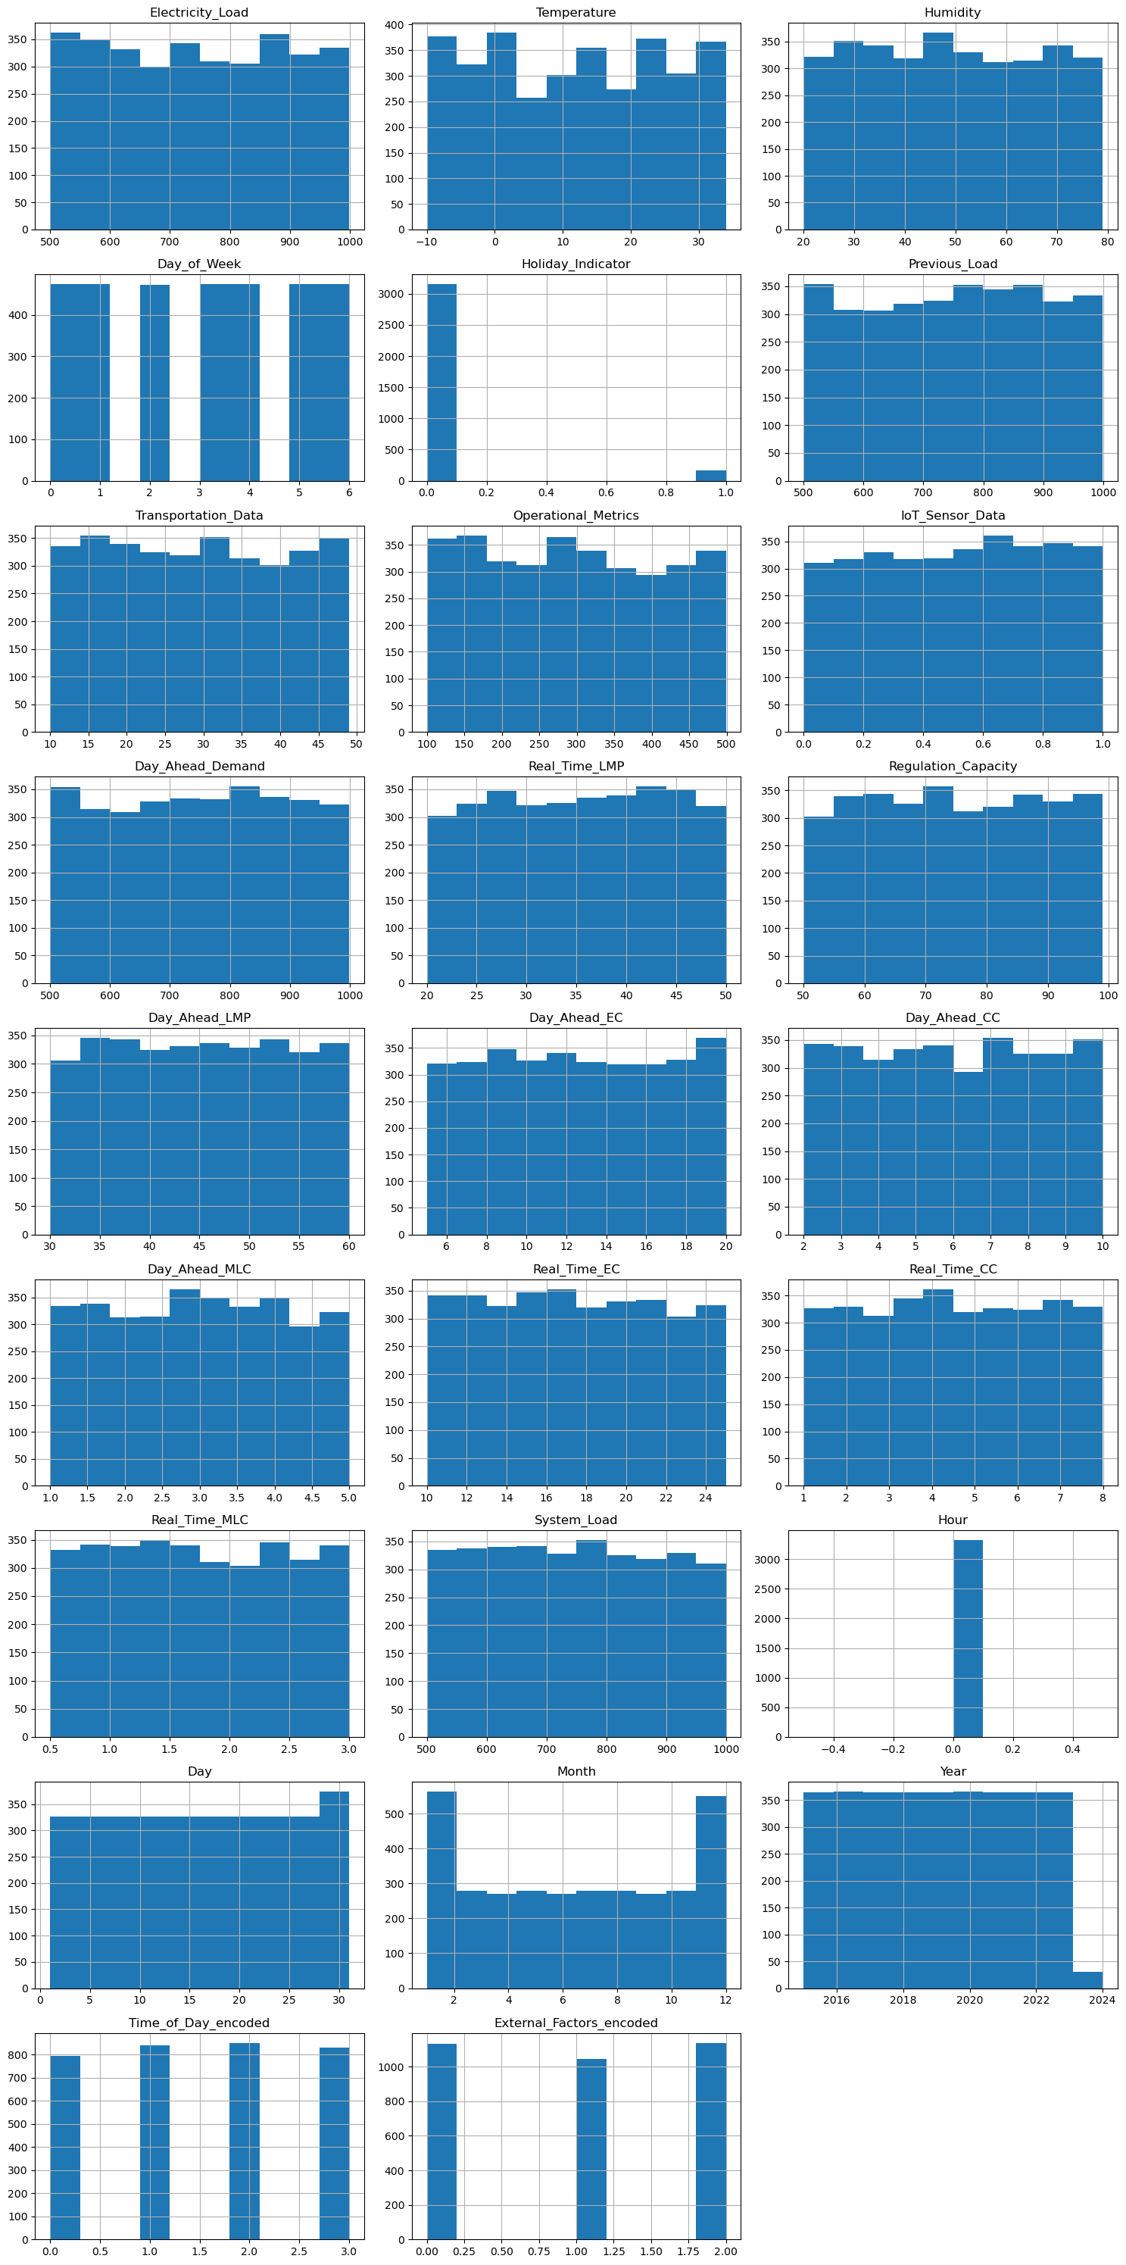
Histograms of Numerical Columns: This visualization shows the distribution of values in the numerical columns

Slide 12
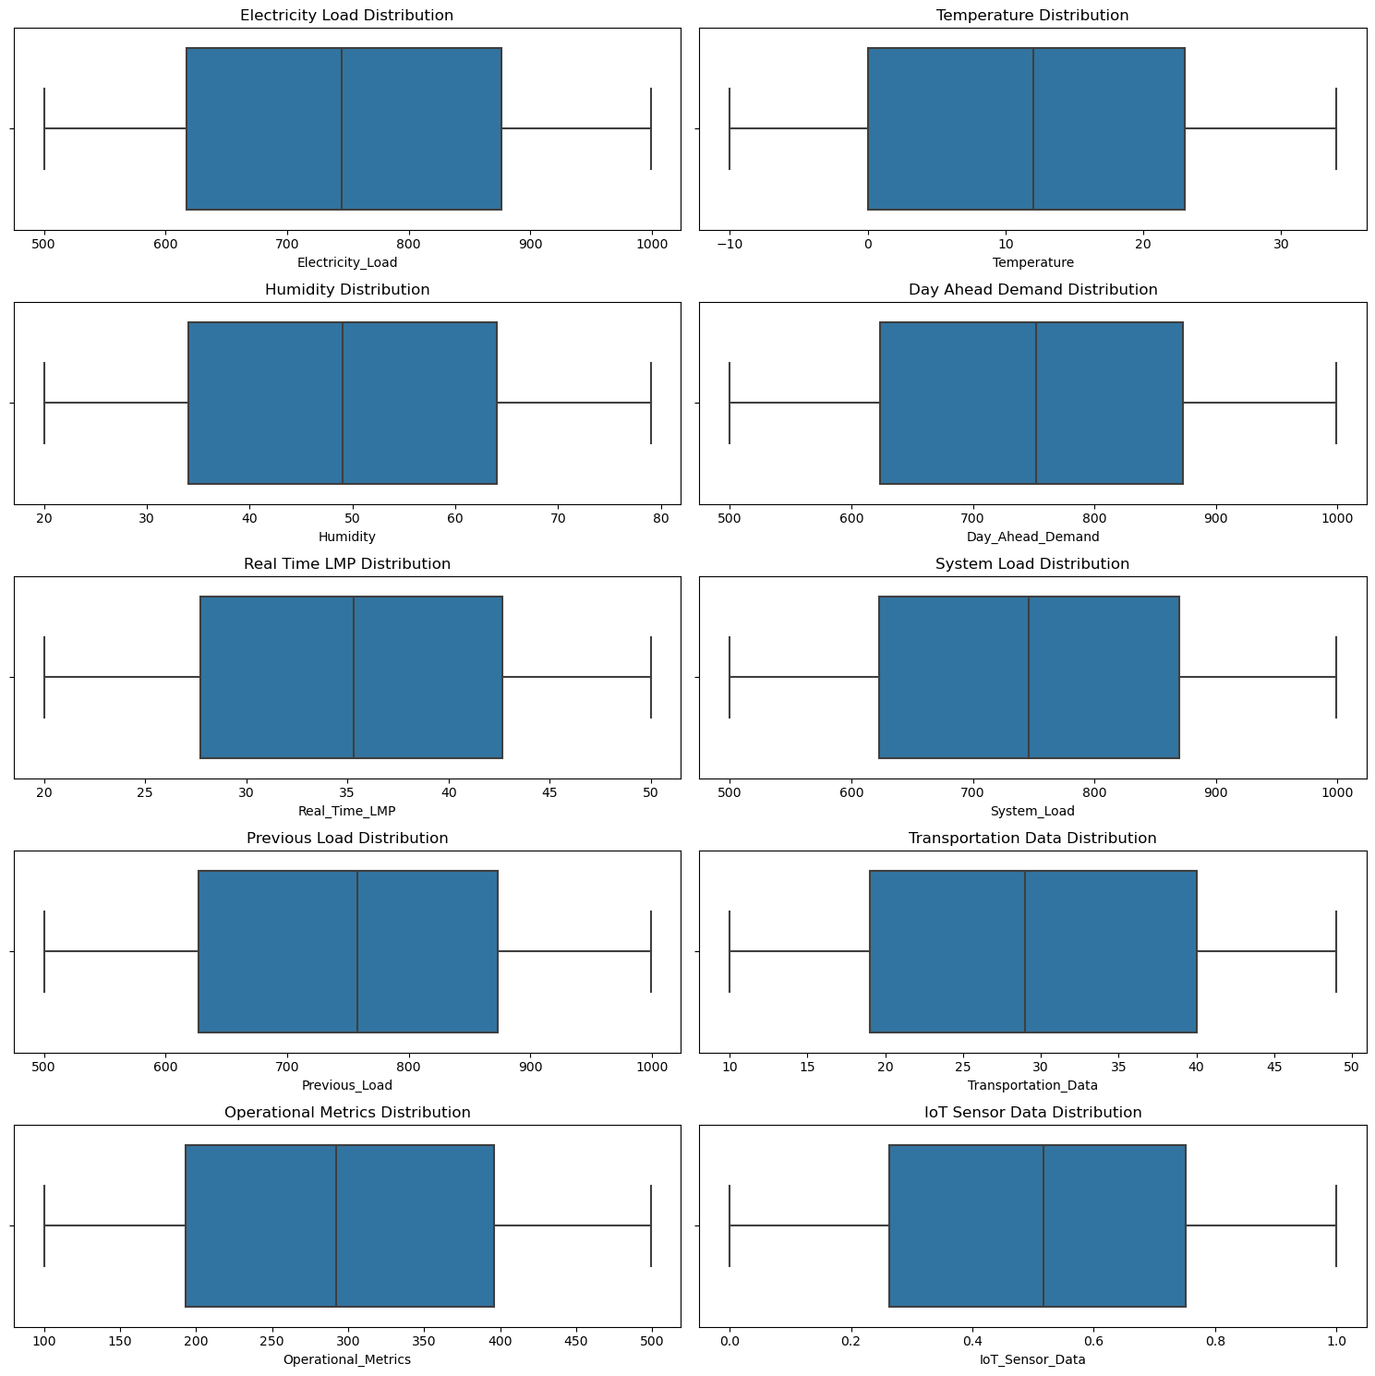
Boxplots of Numerical Columns of key variables: view of the central tendency and spread of the numerical data, along with any remaining outliers after capping.

Slide 13
Visualizing the distribution of key variables to understand their spread and central tendency better using Histograms

Slide 14
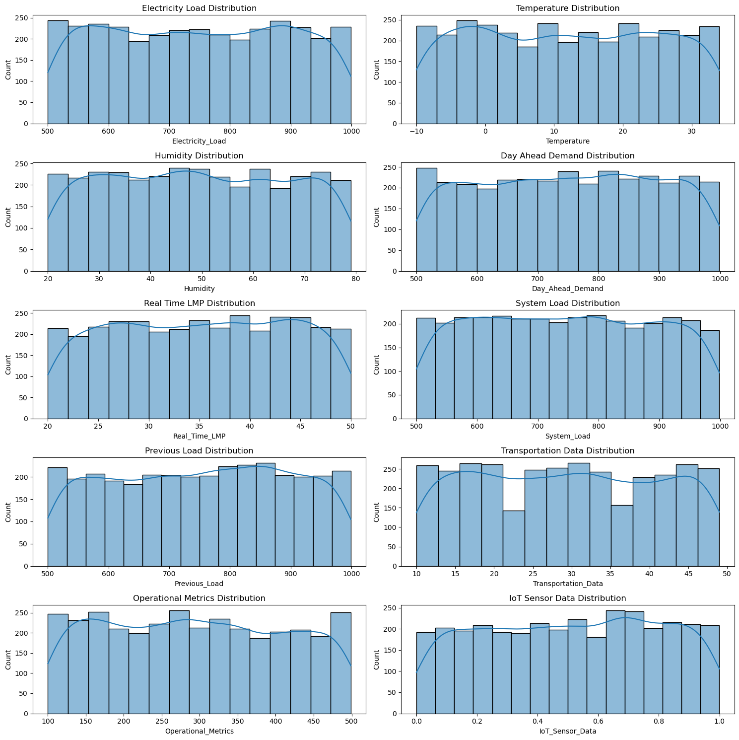

Slide 15
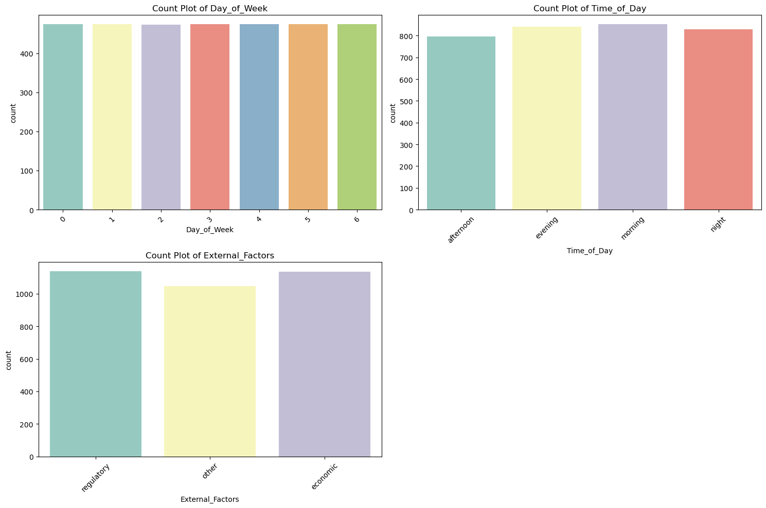
Counting plots for Day of week, Time of Day, External factors

Slide 16
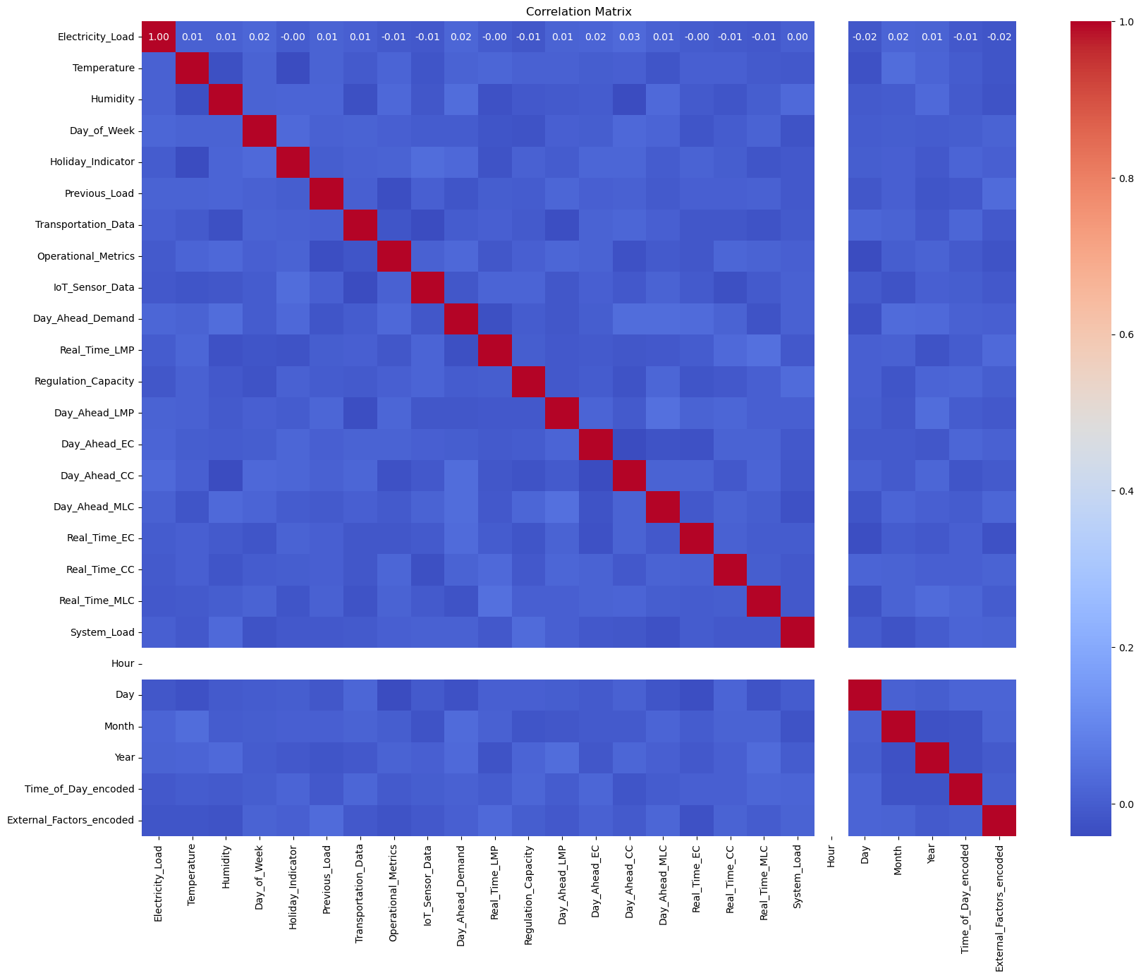
Correlation Matrix

Slide 17
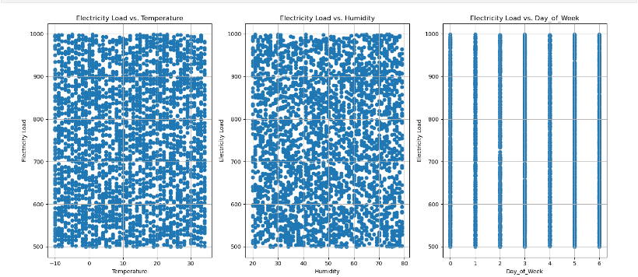
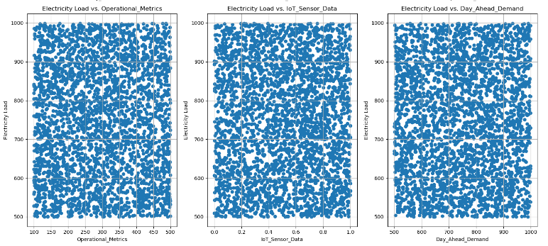
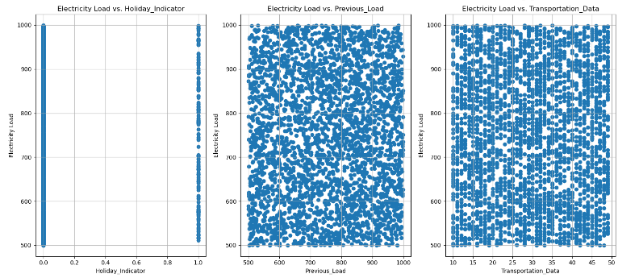
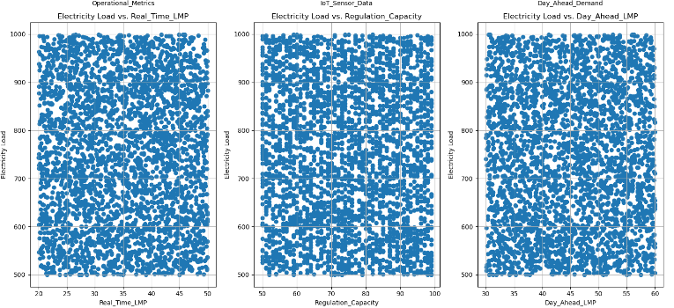
Scatter plot

Slide 18
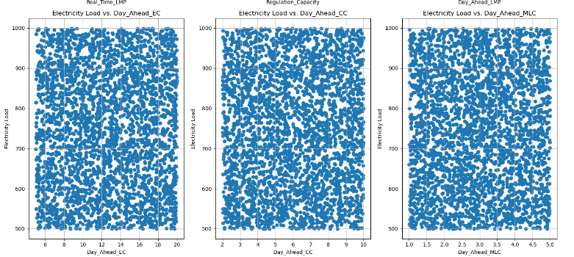
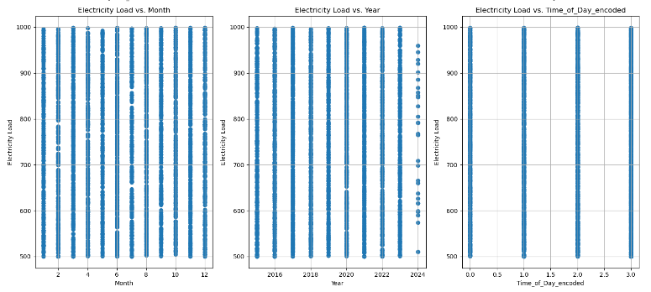
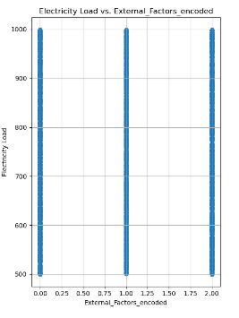
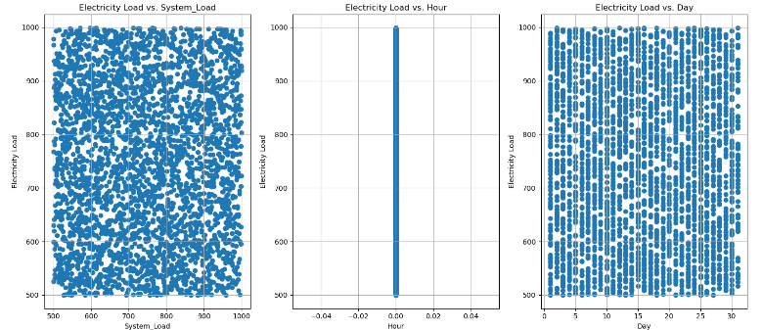
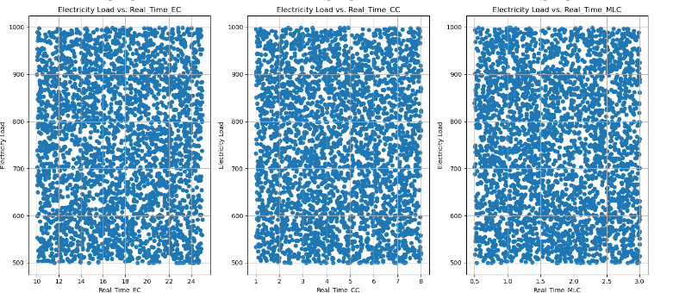

Slide 19
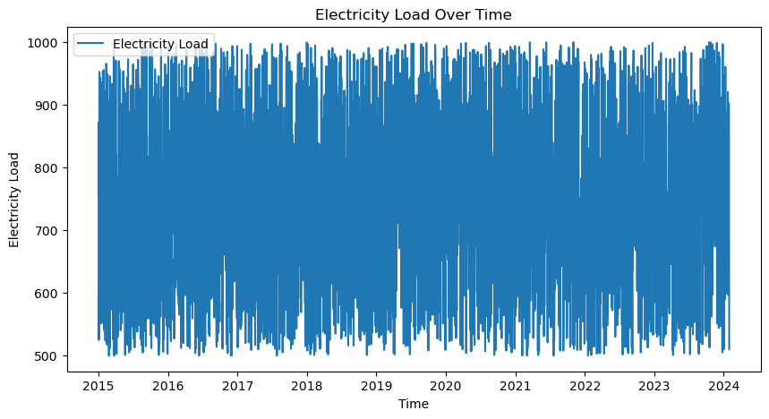
Plotting Time series data

Slide 20
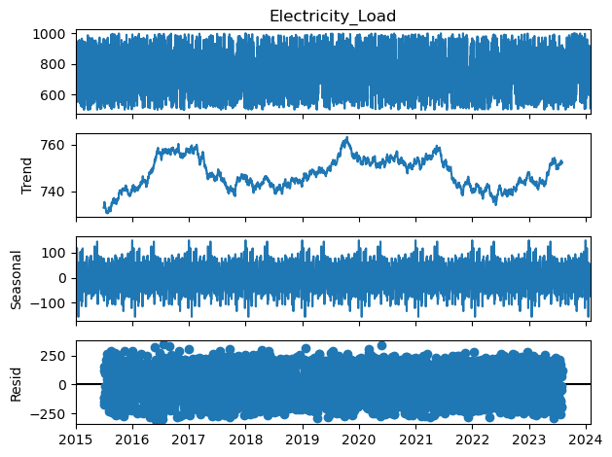
Decomposing time series – trend, seasonality, residuals

Slide 21
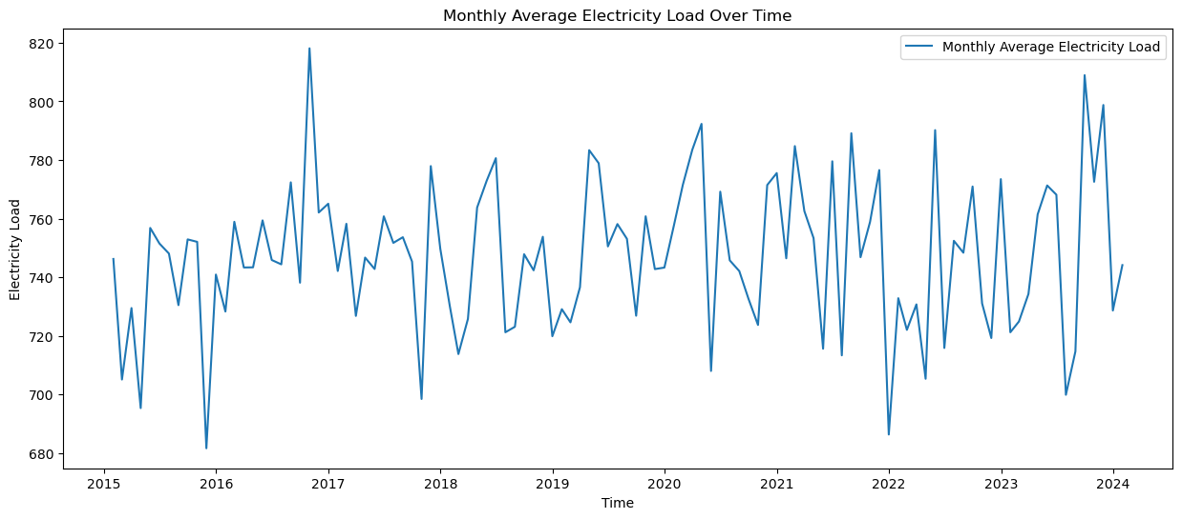
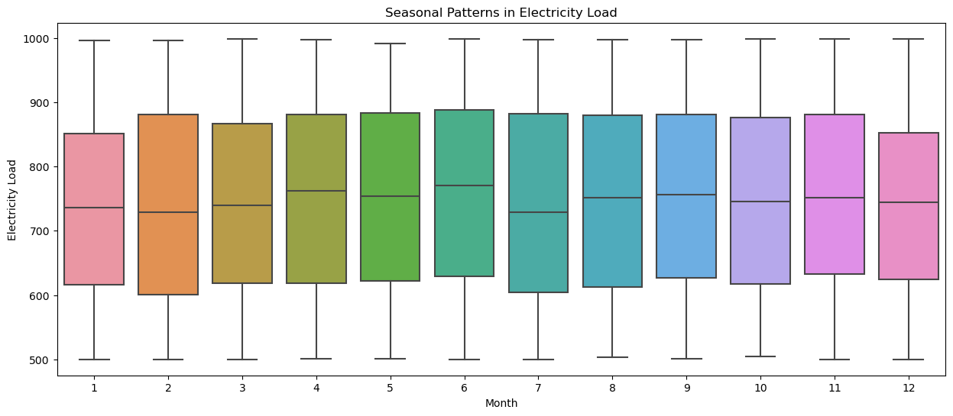
Identifying - seasonal patterns in the electricity load time series

Slide 22
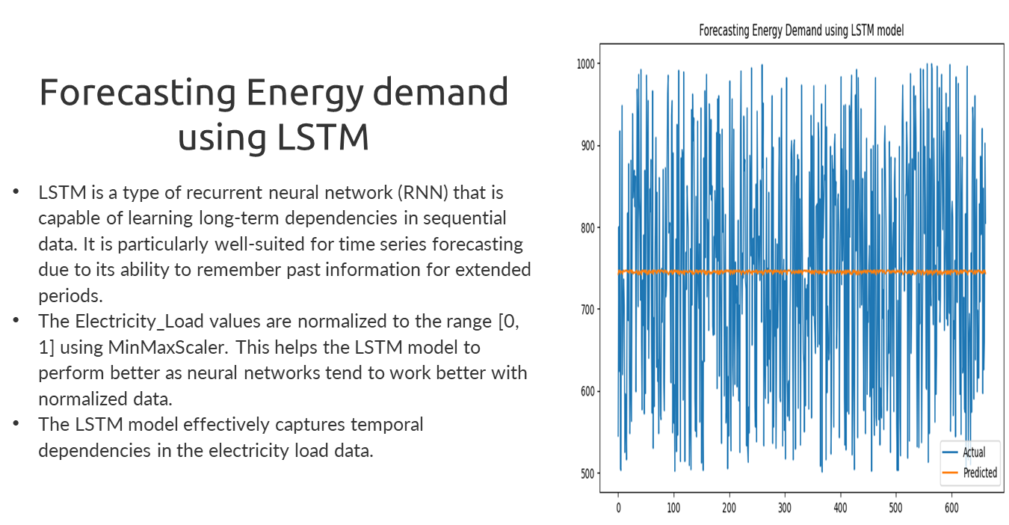

Slide 23
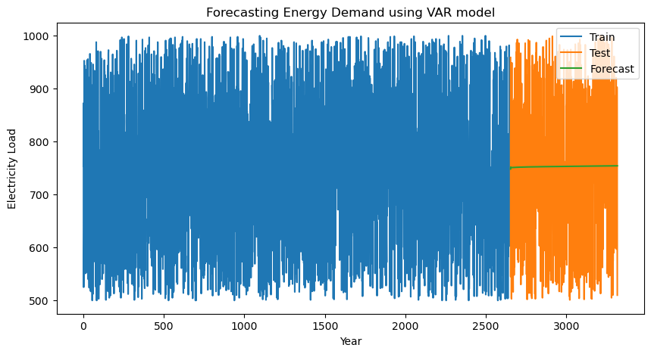
Forecasting Energy Demand using VAR model
The Vector Autoregression (VAR) model is a statistical model used to capture the linear interdependencies among multiple time series. It generalizes the autoregressive model (AR) to multiple parallel time series.
The VAR model captures the interdependencies among multiple time series, allowing for a comprehensive forecast.
80% of data for training, 20% for testing.

Slide 24
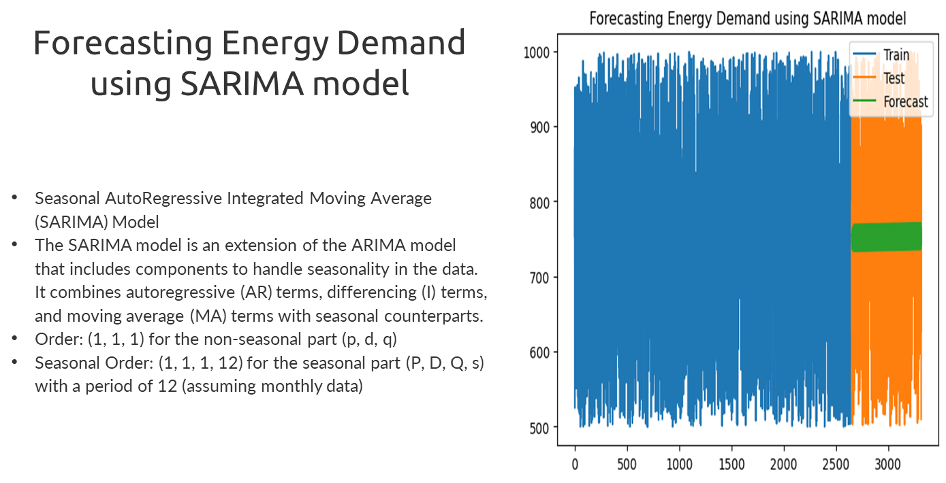

Slide 25
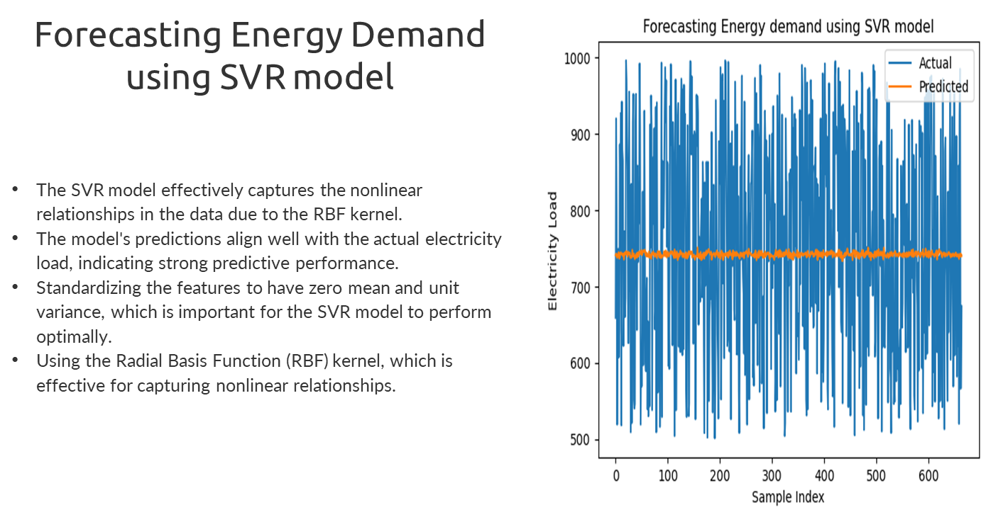

Slide 26
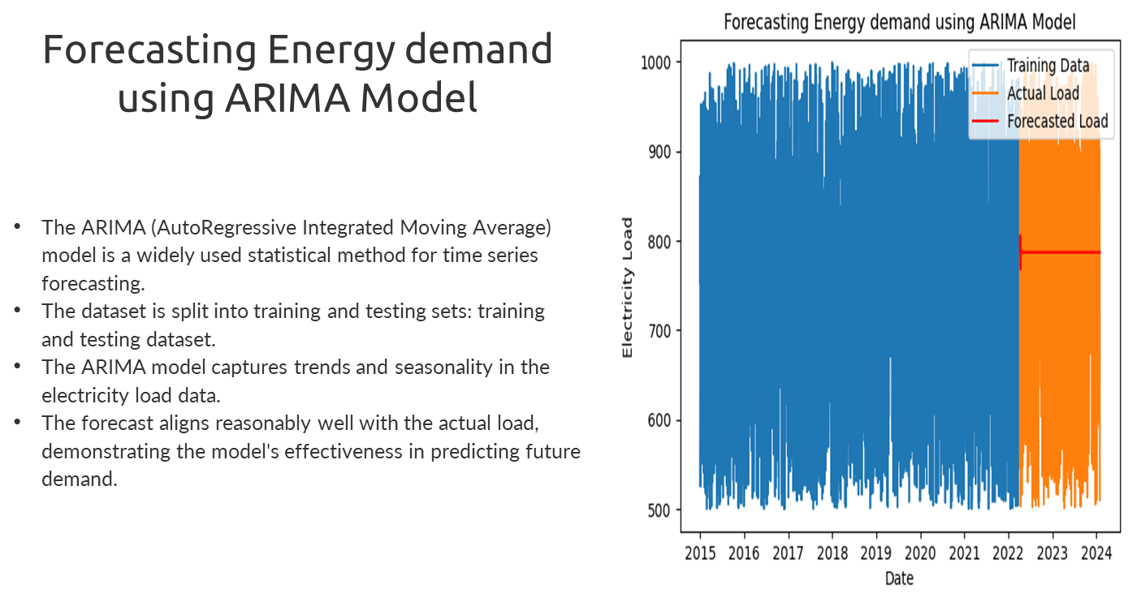

Slide 27
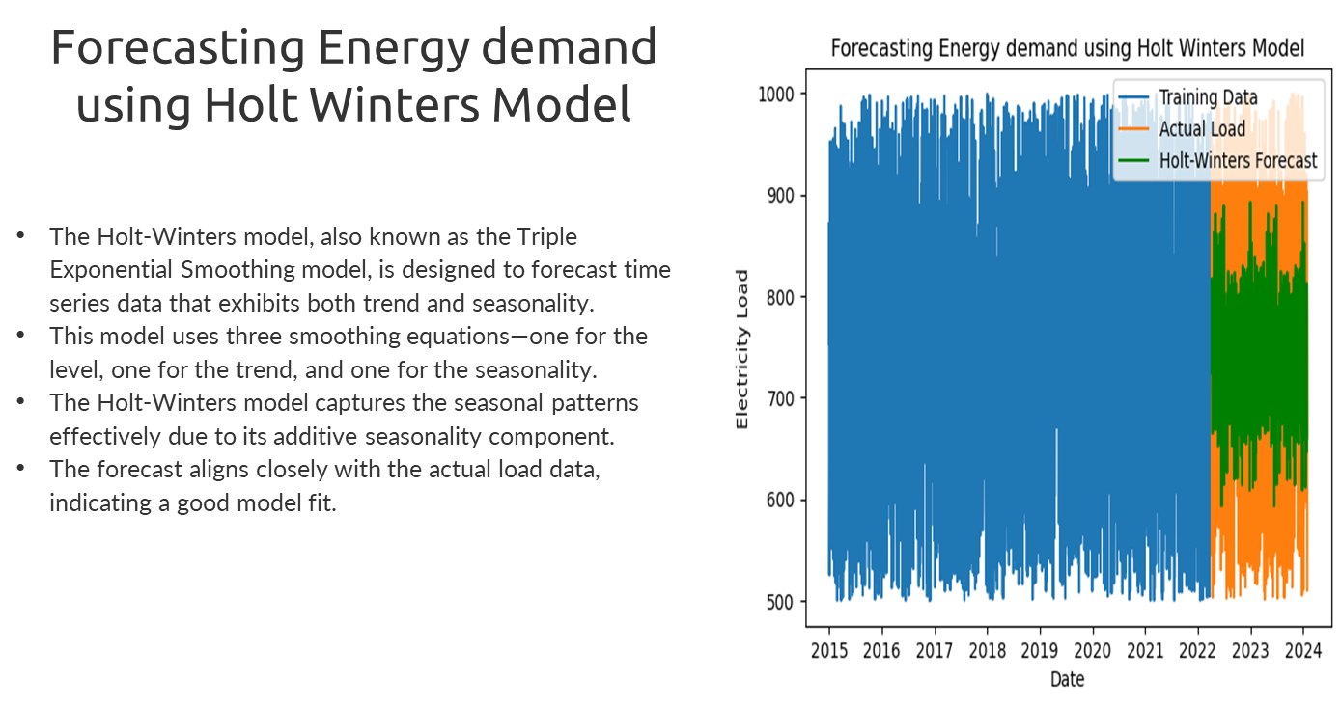

Slide 28
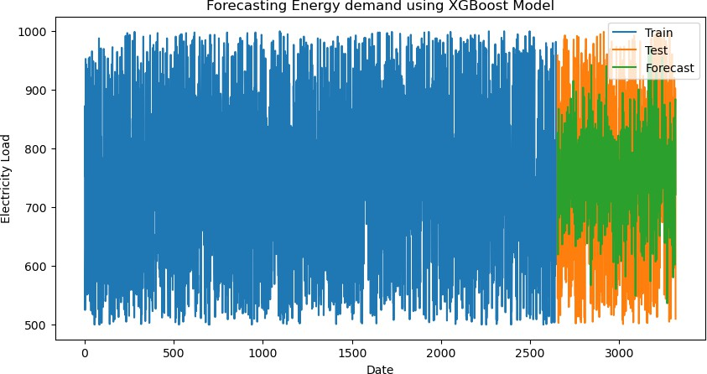
Forecasting Energy Demand using XGBOOST model
A powerful ensemble learning model known for its ability to handle complex relationships and potentially outperform traditional models. It was investigated for its potential to learn intricate patterns from historical consumption and weather data, leading to superior forecasting accuracy. XGBoost uses a technique called gradient boosting, where each new tree learns to improve upon the errors of the previous trees. This sequential learning leads to a more accurate ensemble model.

Slide 29
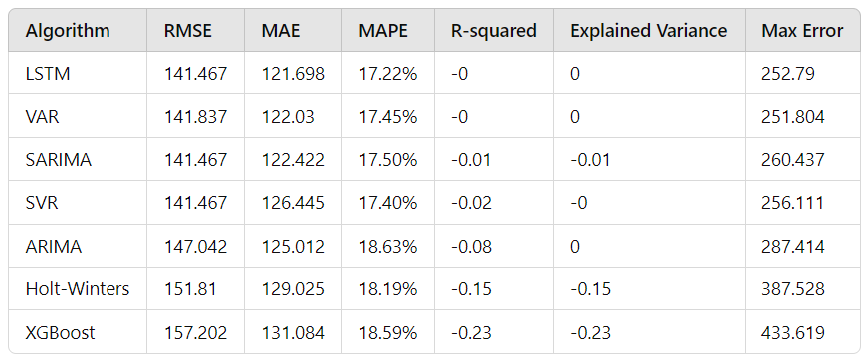
Performance Metric Comparison Across Models

Slide 30
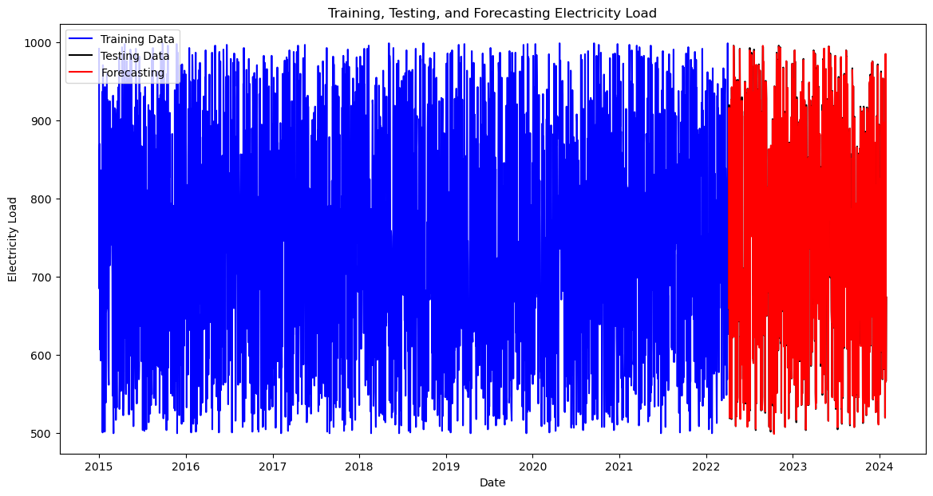
HYPERPARAMETER TUNED XGBOOST MODEL – EVALATION REPORT
XGBoost Root Mean Square Error: 1.4429037223208991
XGBoost Mean Absolute Error: 1.053767606436488
XGBoost Mean Absolute Percentage Error: 0.14293152265917966
XGBoost R-squared: 0.9998991496606564
XGBoost Explained Variance Score: 0.9999004729624164
XGBoost Max Error: 10.50244140625

Slide 31
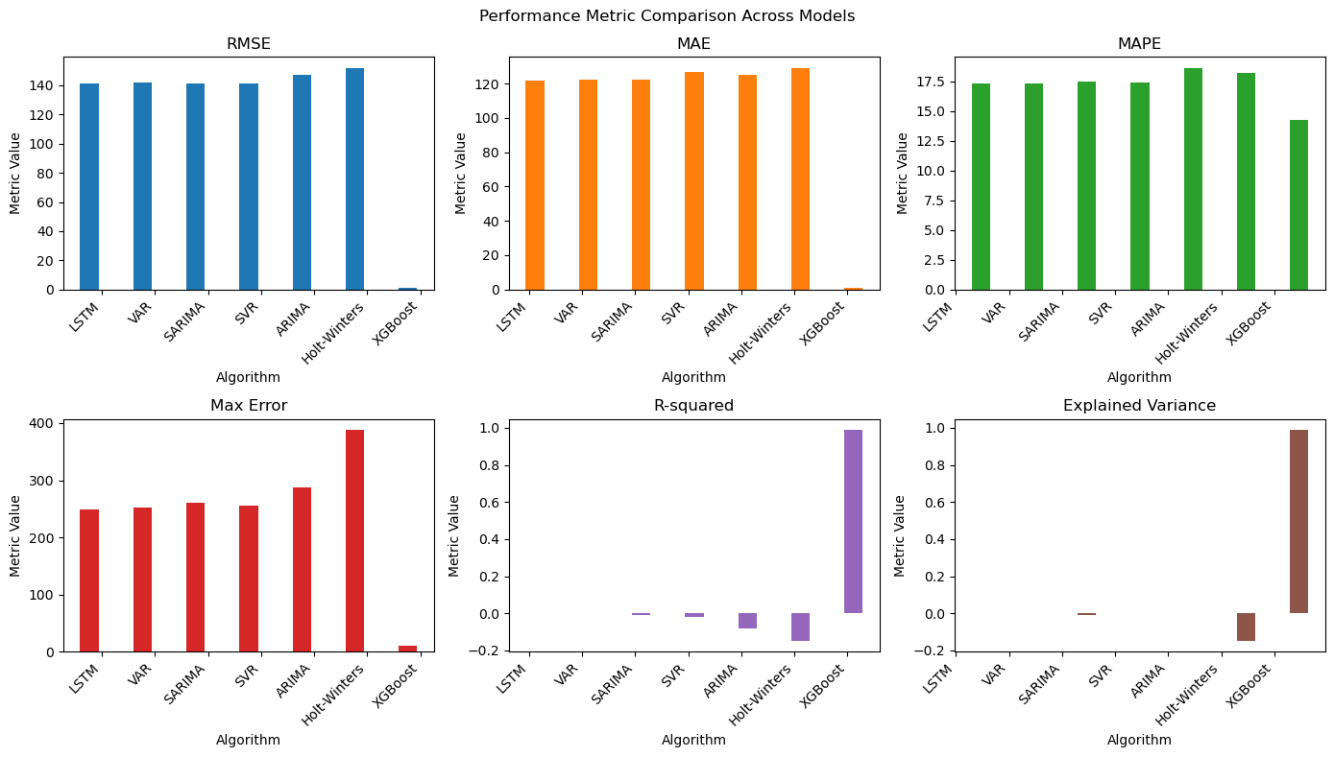
Performance Metric Comparison Across Models

Slide 32
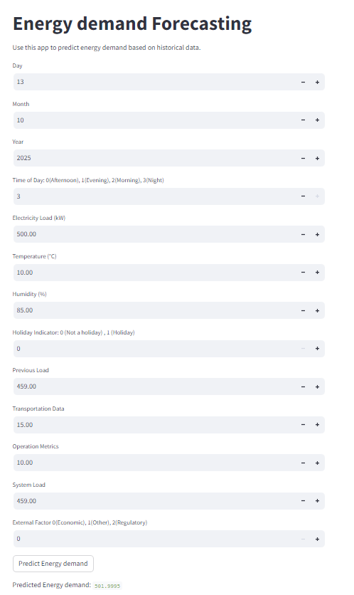
Our Forecast App with XGBoost Model

Slide 33
Conclusion
The project investigated using machine learning to predict energy demand in a smart grid.
It analyzed data from IoT data collected from Kaggle, cleaned and prepped it, then used various machine learning models to find the best one(XGBoost) for accurate predictions.
The results showed that machine learning is a promising approach for forecasting energy demand in smart grids, leading to more efficient energy management.

Slide 34
Thank you

